Slide 1
Sample Groups

Slide 2
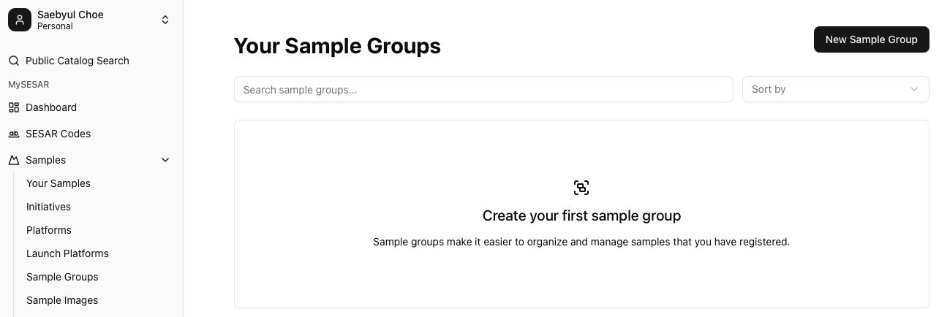
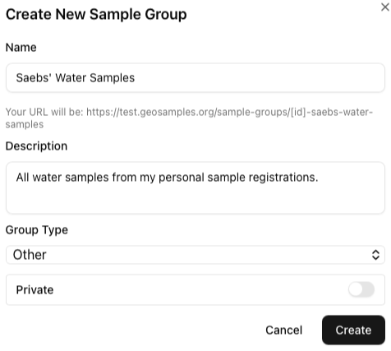
Creating A Sample Group
Create a sample group to organize your samples based on lab/analyses, award, loan or other.
Create a name and description (optional).
Set your Group to Private or Public.

Slide 3
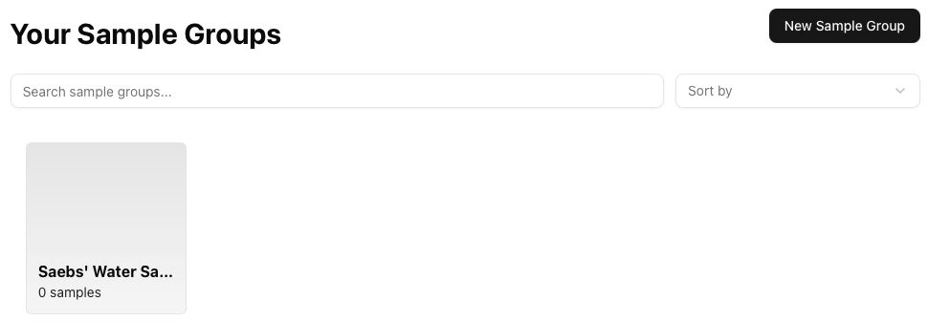
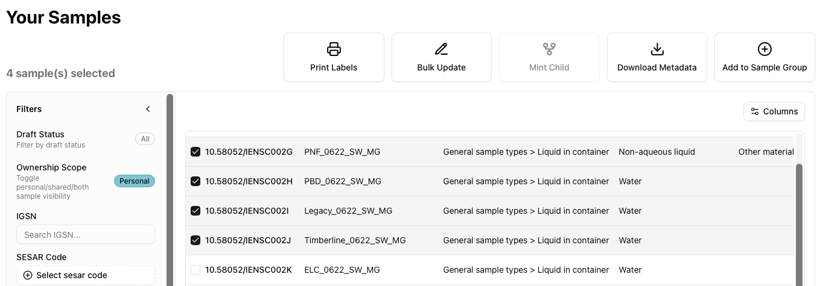
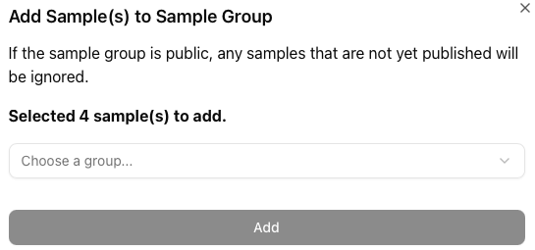
Adding to Sample Group
1
2
3
To add samples to your group, return to the Samples page.
Select the samples to add to Sample Group.
Select the group you want to add the samples to.

Slide 4
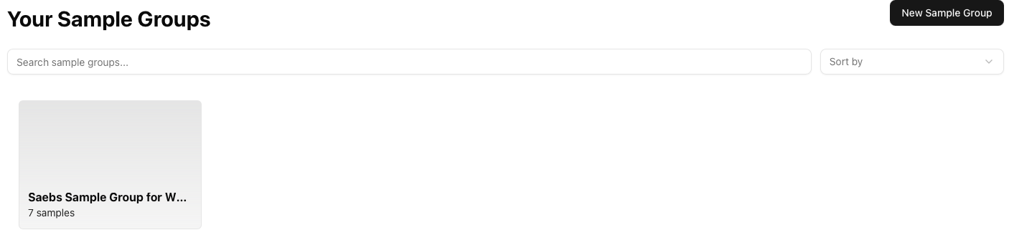
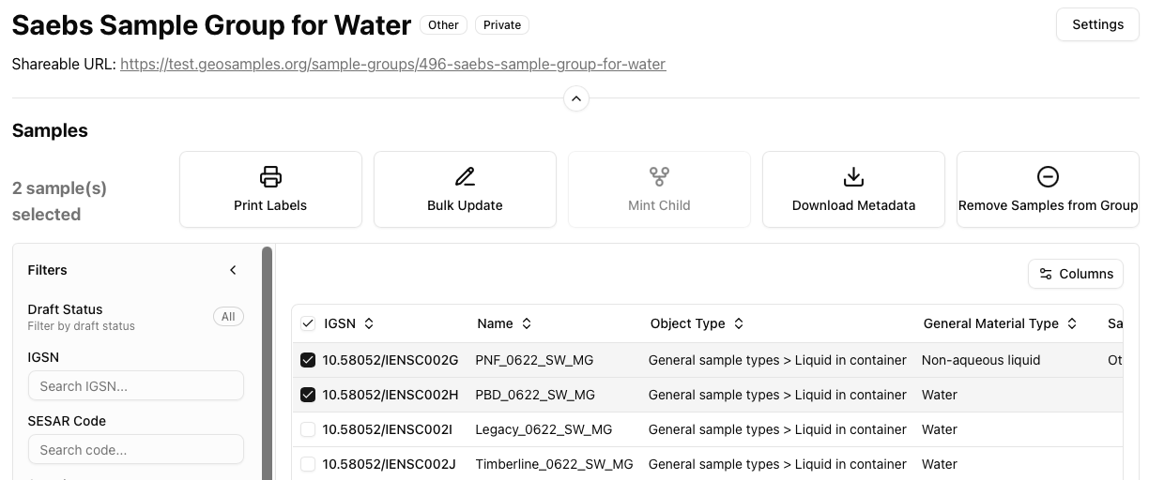
Removing & Deleting Sample Group
You can share your group and associated records by clicking the Shareable URL to copy.
Click your group to access the samples associated with it.
Click on the samples you want to remove.
Click Remove Samples from Group.

Slide 5
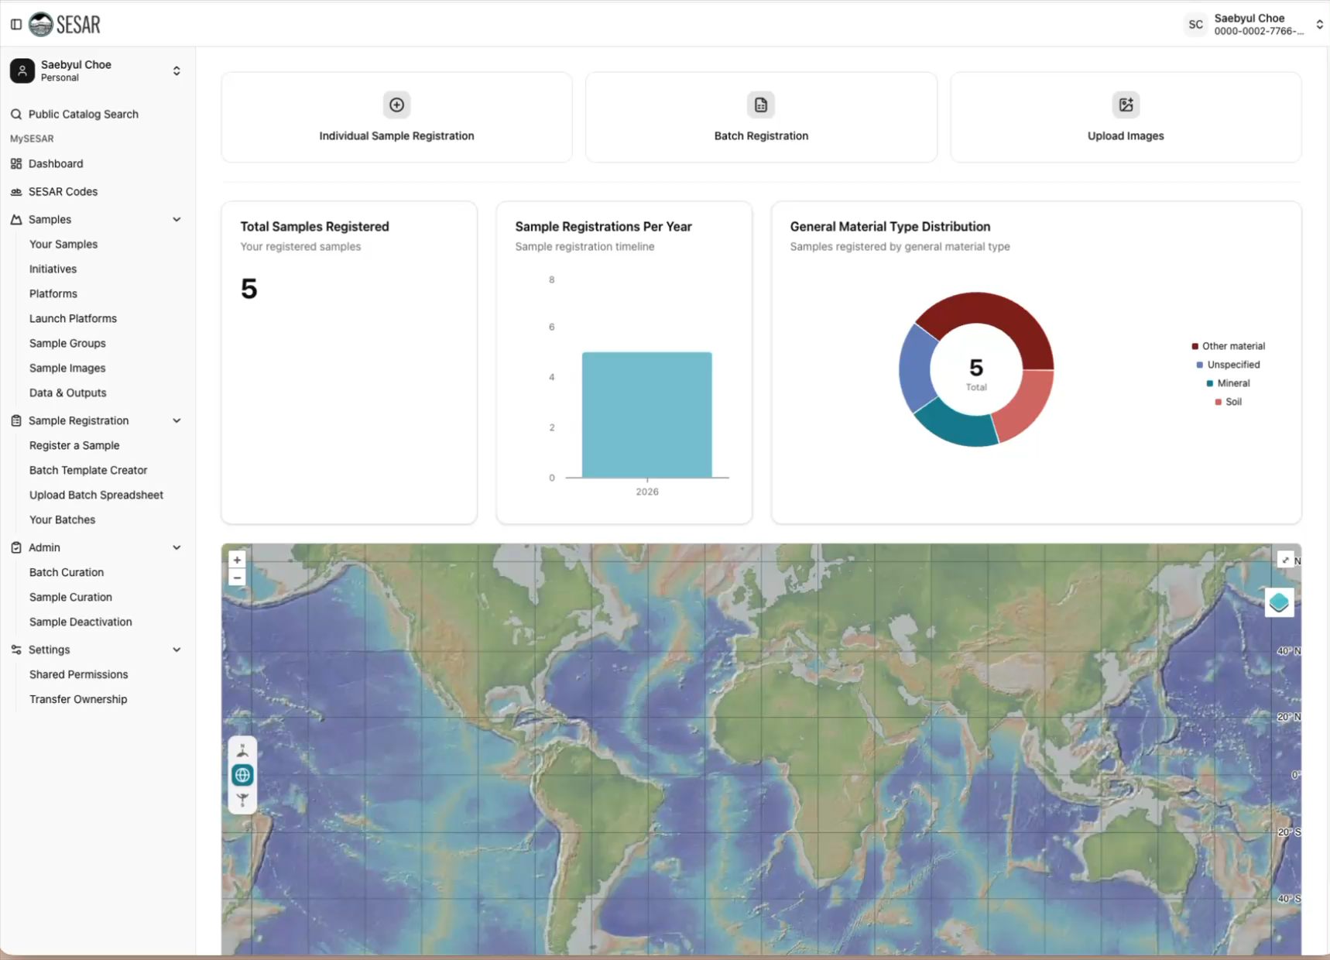
VIDEO Tutorial

